Slide 1
TRAINING AND DEVELOPMENT
#WEAREROYALPADEL

Slide 2
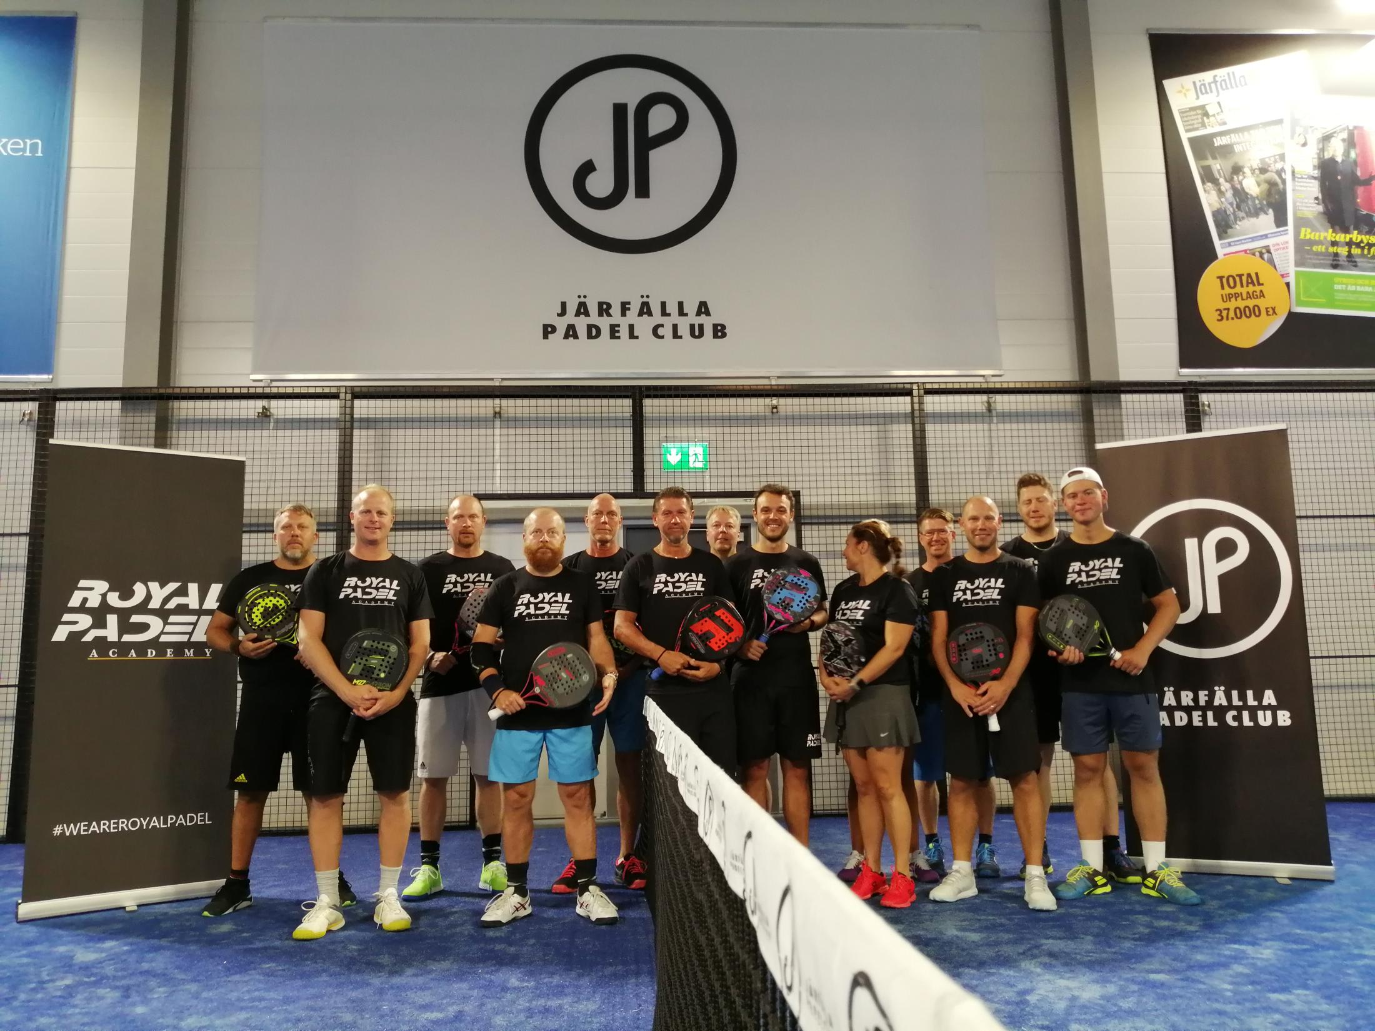
CONTENTS
OUR CONCEPT
THE PLAN
OUR PROGRAM
OUR GOAL
#WE ARE ROYALPADEL

Slide 3
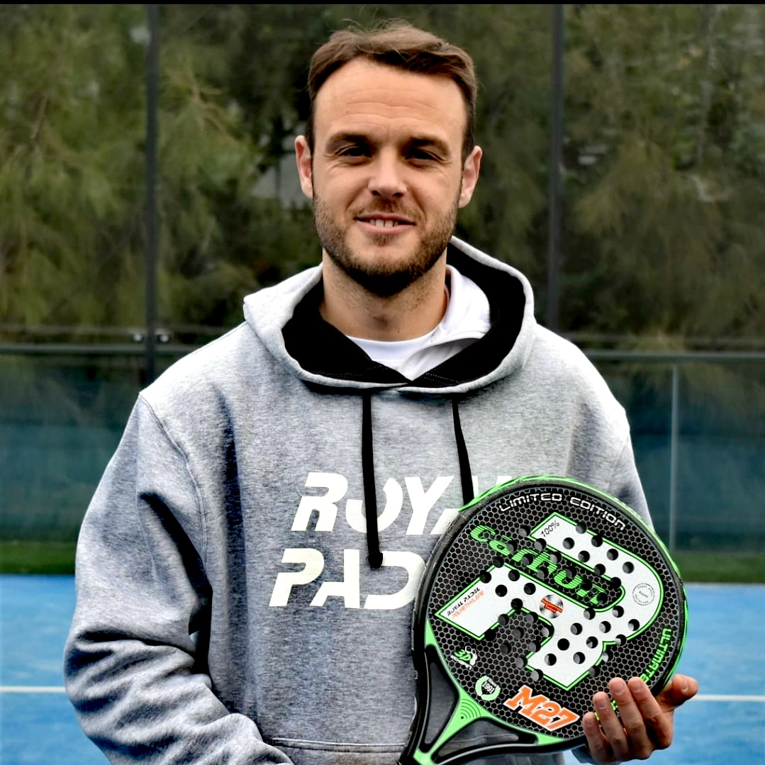
FEDE VIVES Director of training and development
WE ARE @ ROYAL PADEL
OUR CONCEPT
SINCE ROYAL PADEL WAS FORMED IN 1991 WE HAVE ALWAYS LOOKED TO PROVIDE BOTH PLAYERS AND COACHES THE BEST POSSIBLE SUPPORT TO IMPROVE THEIR GAME.
WITH THE HELP OF OUR PADEL DIRECTOR AND OUR TEAM OF CERTIFIED LEVEL 1 COACHES WE WOULD LIKE TO SHARE OUR KNOWLEGDE WITH YOU AS PART OF OUR
WE ARE ROYAL PADEL PROGRAM.

Slide 4
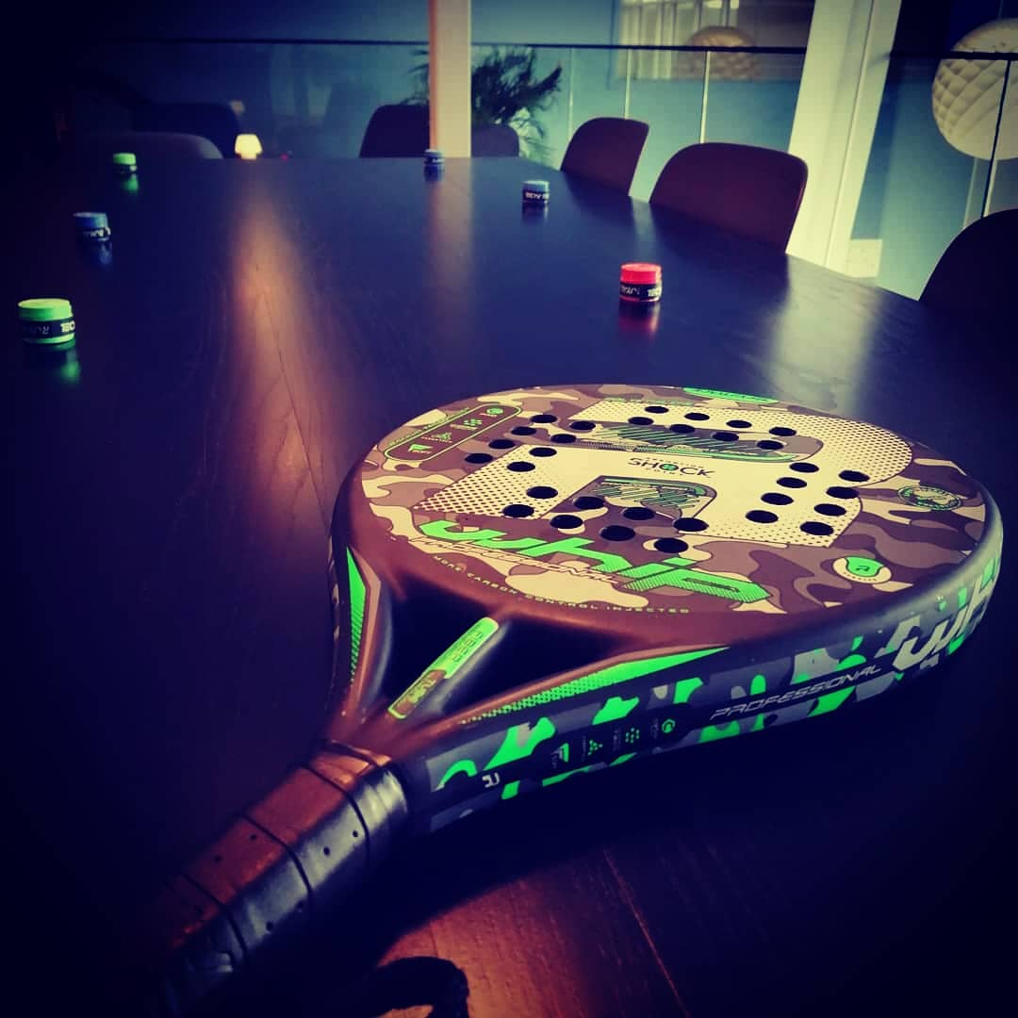
THE PLAN
ROYAL PADEL ARE LOOKING TO SET UP OUR DEDICATED TRAINING PROGRAMS FROM INICIATION LEVEL TO PRO / COMPETITION PLAYERS.
EACH CLUB AND CLUB COACH AFFILIATED WITH OUR PROGRAM WILL RECIEVE THE BEST POSSIBLE SUPPORT AND CONTINUOUS HELP TO PROVIDE THE BEST EDUCATION TO EVERY SINGLE CLUB MEMBER.
WE ARE @ ROYAL PADEL
WE ARE ROYAL PADEL
PROGRAM
EXCLUSIVE SET UP WITH YOUR CLUB WITHIN THE REGION.
ASSESMENT PROGRAM FOR COACHES AND CLUB MEMBERS.
INICIATION OF PLAYER ACADEMY WITH OUR DIRECTOR OF PADEL FEDE VIVES.
STRUCTURED PLAYER GROWTH
PROGRAMS FULLY CERTIFIED BY
ROYAL PADEL COACHES
ADDITIONAL COACHING EVENTS PROVIDED TO CLUB MEMBERS IN ONE OF BARCELONAS TOP CLUBS.

Slide 5
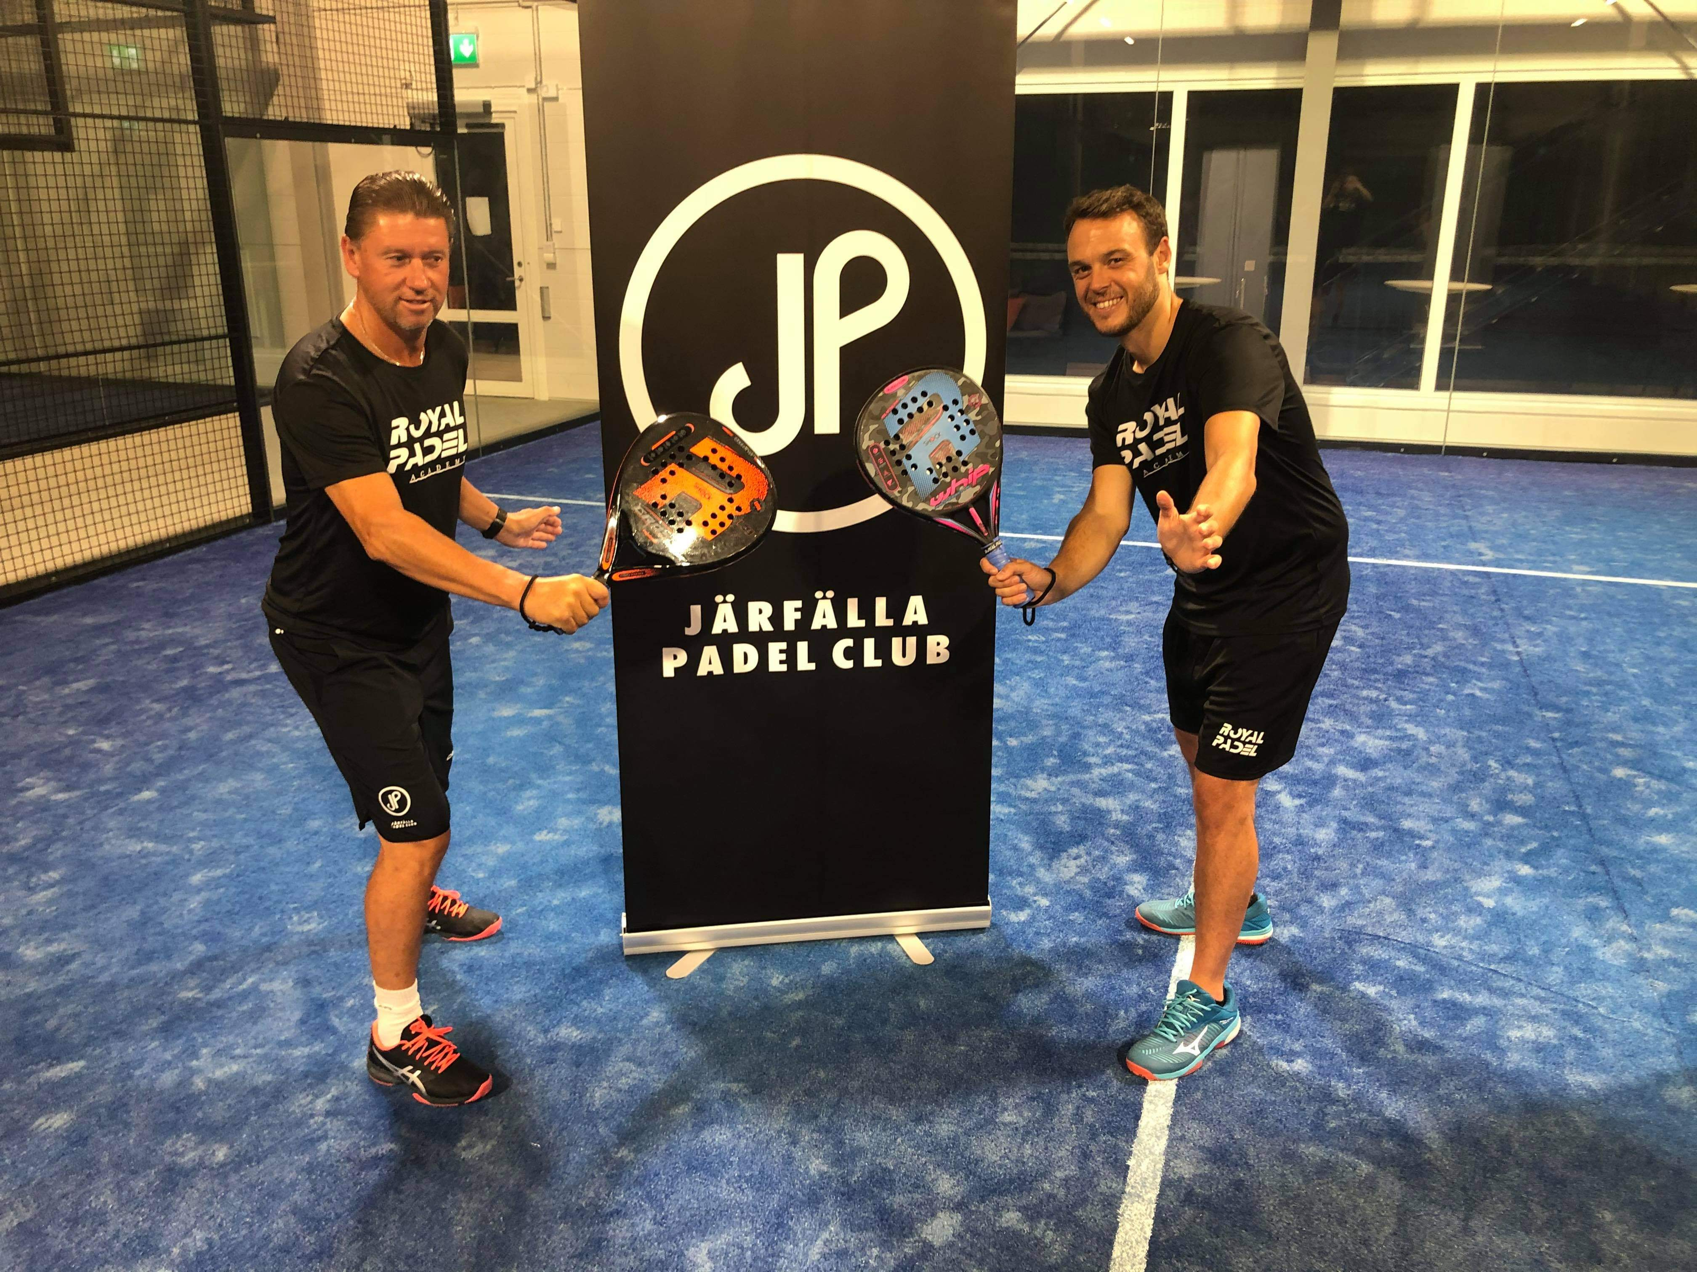
ROYAL PADEL CLINICS AND EVENTS
BEING AFFILIATED WITH THE ROYAL PADEL ACADEMY PROVIDES YOU WITH BENEFITS FOR ALL CLUB MEMBERS DURING THE YEAR.
CLINICS AND CLASSES
ROYAL PADEL CLINICS 3 HOURS WITH VIDEO ANALYSIS
- INITIAL 45 MINUTE WARM WITH COORDINATION DRILLS AND TEAM BUILDING
EXERCISES
- CLINIC SPECIFIC SHOT EXPLANATION AND FULL BREAK DOWN
- GROUPS SEPERATED AND SPECIFIC SHOT WORK BEGINS
- VIDEO ANALYSIS OF SPECIFIC SHOTS OF THE DAY PER ATENDEE
- MATCHES INVOLVING SHOTS SPECIFIC TO CLINIC
BARCELONA WEEKEND EVENTS
- DURING THE YEAR ROYAL PADEL WILL INVITE AFFILIATE CLUB MEMBERS
FOR COACHING WEEKENDS CLINICS AND LOCAL TOURNAMENTS.
- CLUB MEMBERS WILL RECIEVE UP TO 30% DISCOUNT.
- EVENTS WILL BE UPDATED AND FURTHER DETAILS TO FOLLOW IN COMING
MONTHS FOR 2021 PROGRAM

Slide 6
ROYAL PADEL CLINIC CONDITIONS
HERE IS A BREAKDOWN OF OUR CLINICS FOR ATTENDEES
-CLINICS WILL LAST 3 HOURS AND WILL BE
BEGINNER -
INTERMEDIATE -
ADVANCED -
-IT IS IMPORTANT THE CLUB TRY TO CONTROL LEVELS FOR OPTIMUM LEARNING OF THE ATENDEES
-CLINIC DATES WILL BE AGREED AND PROMOTED A MINIMUM OF 30 DAYS FROM SET EVENT DATES.
-CLINIC COST SET AT 50.00 EURO PER PERSON
(COURT COSTS MUST BE AGREED UPON AND SET ANNUALLY )
-2 X ROYAL PADEL COACHES WILL BE PROVIDED FOR EACH CLNIC.
CLUBS AFFILIATED WITH THE ACADEMY WILL RECIEVE A 10% DISCOUNT FOR ALL CLINICS AND PRIVATE CLASSES FOR MEMBERS.
CLUBS MAY ALSO INCREASE CLINIC COST BY A MAXIMUM OF 20 EURO PER PERSON.
-EACH CLINIC WILL CONSIST OF MINIMUM 8 PEOPLE
MAXIMUM 12 IN TWO COURTS AVAILABLE
- THE CLUB WILL PROVIDE
MINIMUM OF 3 CLINICS
MAXIMUM OF 5 CLINICS
OVER A 48 HOUR PERIOD
( NORMALLY SET OVER A WEEKEND )

Slide 7
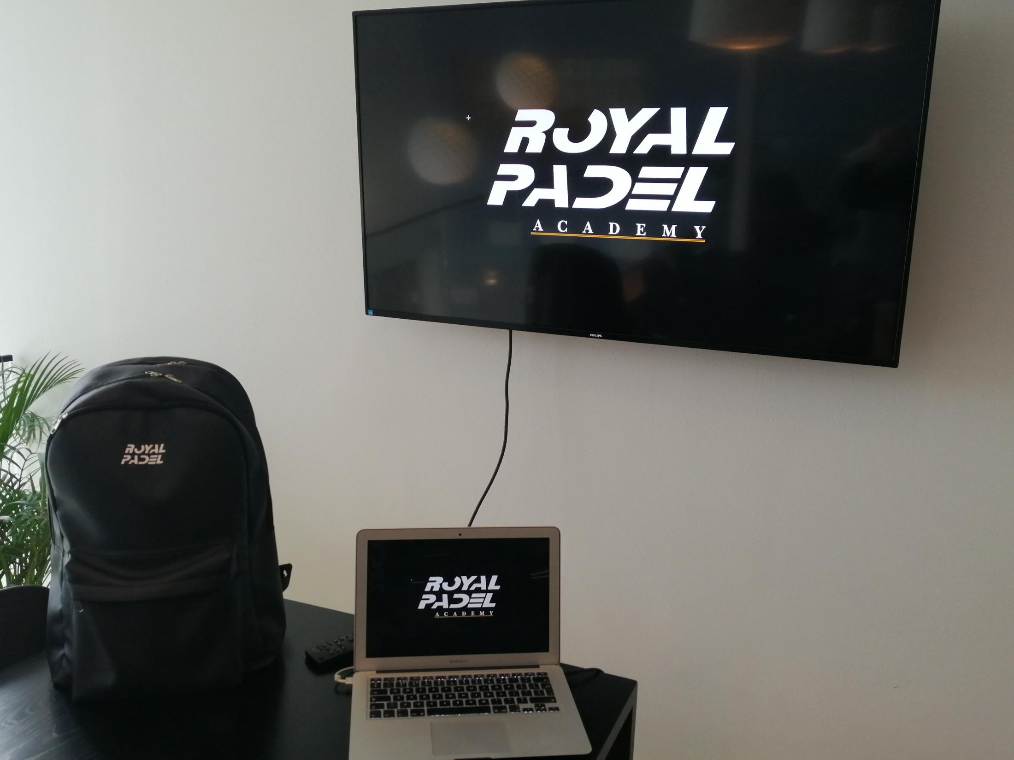
ROYAL PADEL COACHING COURSES
WITHIN EACH COUNTRY ROYAL PADEL WILL WORK EXCLUSIVLY WITH ONE CLUB RESPONSIBLE FOR ALL ACADEMY COACHING COURSES THROUGHOUT THE YEAR.
EACH COURSE WILL CONSIST OF THE FOLLOWING
- ACADEMY COACHES WILL MEET WITH THE CLUB 24 HOURS BEFORE TO SET UP AND
DISCUSS ANY ISSUES OR ANSWER ANY QUESTIONS.
DAY 1
- WELCOME PACK PROVIDED TO ALL COURSE ATENDEES
- INTRODUCTION TO SPECIFIC COURSE WITH CLASSROOM PRESENTATION AND
BREAK DOWN OF WHAT IS REQUIRED OVER THE 48 HOUR COURSE.
- COURT WORK BASED ON SPECIFIC COCHING COURSE WITH CERTIFIED ACADEMY
COACHES p
- LUNCH BREAK
- RETURN TO THE COURT FOR THE FINAL FEW HOURS TO WORK ON MORE COURSE
SPECIFIC WORK
DAY 2
- RECAP OF DAY 1 WITH Q&A SESSION
- PHOTO SESSION WITH MEMBERS AND COACHES FOR PROMOTION
- FINAL COURT WORK SPECIFIC TO COURSE
- EXAM WITH VIDEO ANALYSIS PROVIDED TO EACH COACH MEMBER rogression of every basic shot

Slide 8
COACHING COURSE CONDITIONS
HERE IS A BREAKDOWN OF OUR COACHING COURSES FOR COACHES
TERMS
-COURSES MUST HAVE A MINIMUM 10 ATENDEES AND MAXIMUM 16 ATENDEES
-CLUB MUST HAVE A MINIMUM OF 2 COURTS AVAILABLE DURING THE COURSE.
- CLUB MUST BE ABLE TO PROVIDE SEATING AREA FOR CLASSROOM MODULES OF SPECIFIC COURSE
CLUBS MUST SETTLE 50% OF THE BALANCE 48 HOURS BEFORE THE COURSE BEGINS, REMAINING
BALANCE WILL BE PAID 24 HOURS AFTER COURT COMPLETION.
- ROYAL PADEL WILL CHARGE EACH COURSE AT 375 EURO PER PERSON / PER COURSE
- EACH AFFILIATED CLUB WITH WILL RECIEVE 25% OF THE COURSE REVENUE.
- ONE FREE PLACE PROVIDED FOR THE CLUB
- CLUB MAY INCREASE COURSE COST BY MAXIMUM 100 EURO FROM PRICE SET BY ROYAL PADEL
WHAT ROYAL PADEL PROVIDE
-BANNERS FOR THE CLUB EXCLUSIVE OF THE ACADEMY
-BALL HOLDERS FOR CLUB COACHES EXCLUSIVE OF THE ACADEMY
-CLOTHING FOR CLUB COACHES FROM ROYAL PADEL
-CLUB HAS 1 FREE SPACE AVAILABLE FOR EVERY COURSE
-ROYAL PADEL PROVIDE ONE PRO COACH AND ONE ASSISTANT COACH FOR ALL EVENTS
-CLUB RETAINS 25% FROM EVERY COURSE FEE TAKEN
-ALL ATENDEES OF THE COURSE RECIEVE WELCOME PACK
-ALL ATENDEES RECIEVE DIPLOMA AND GRADED VIDEO ANALYSIS OF ATENDEE

Slide 9
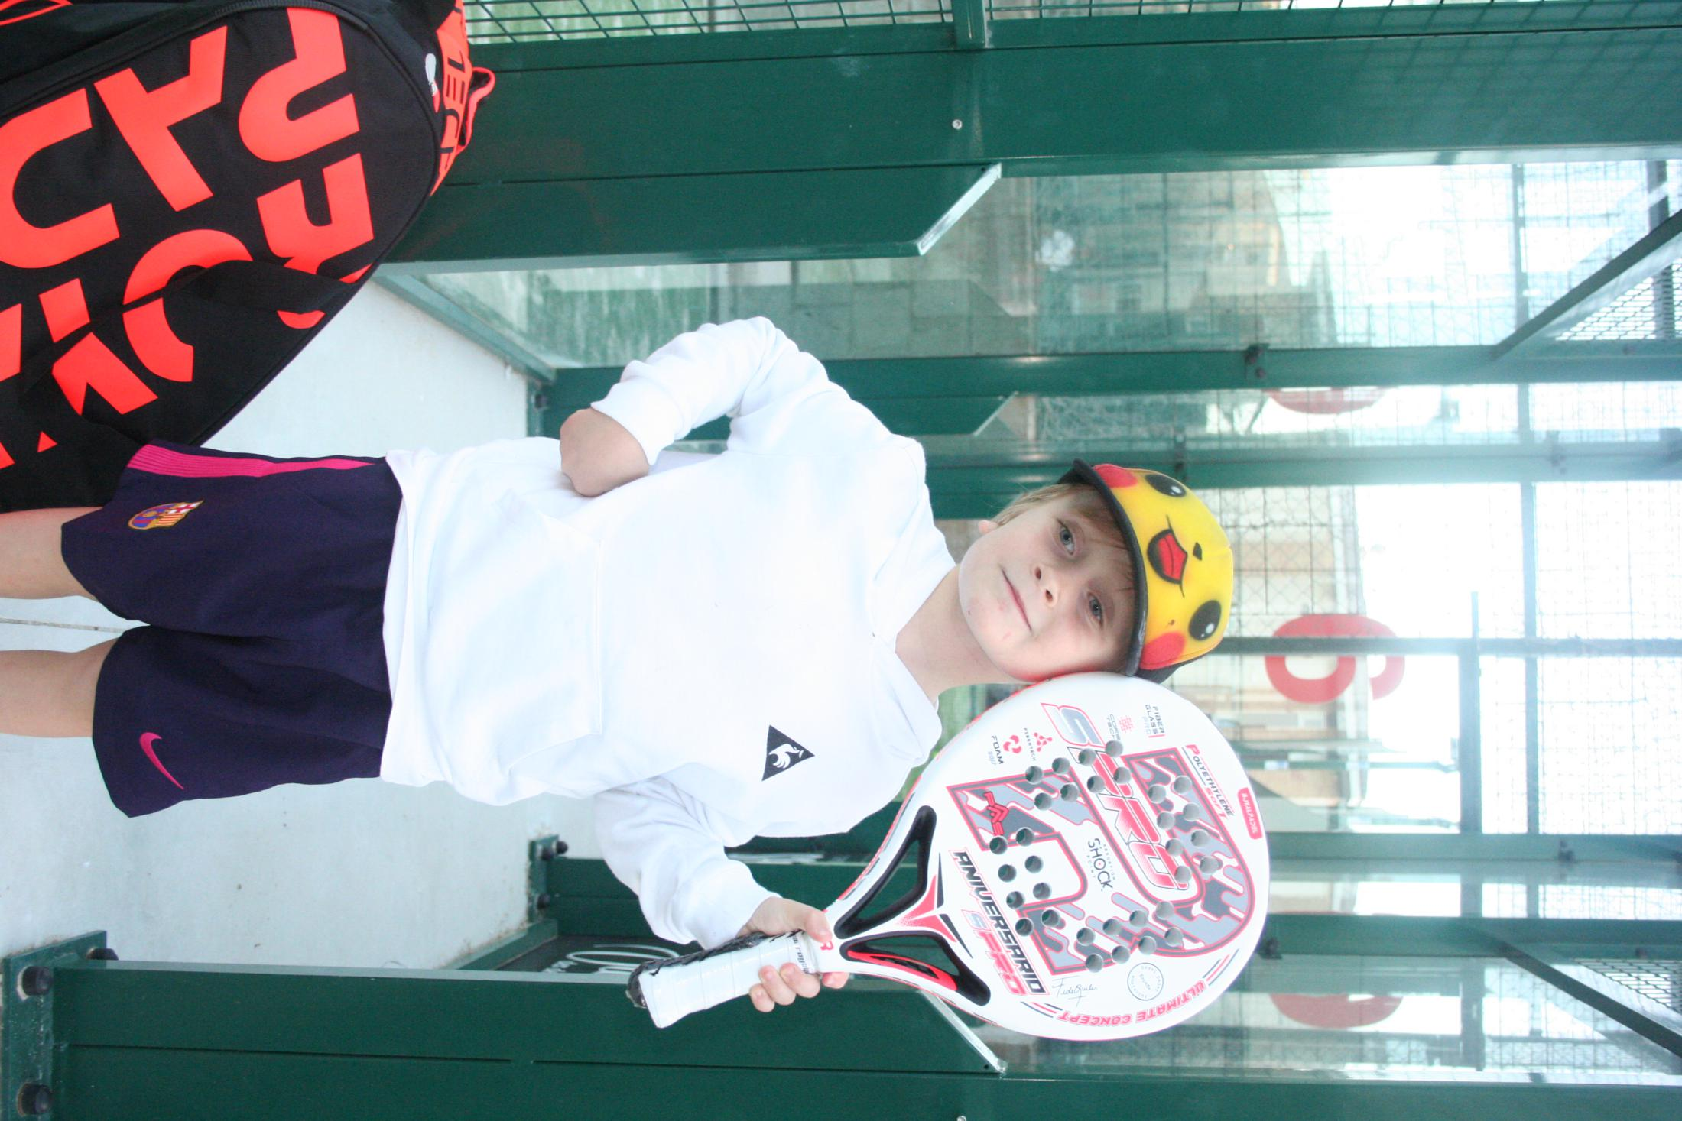
OUR PROGRAM
BEGINNER COACHING PROGRAM
- HOW TO BE THE SUCCESSFUL COACH
- HOW TO PREPARE AND EXECUTE A OPTIMUM
TRAINING SESSION
- HOW TO THROW A BALL CORRECTLY BASED ON
STUDENTS LEVEL.
- THE BASIC SHOTS REQUIRED FOR A BEGINNER
- THE PROGRESSION OF EVERY BASIC SHOT
- THE BASIC TACTICS FOR BEGINNERS
- COMMON MISTAKES AND HOW TO REMEDY

Slide 10
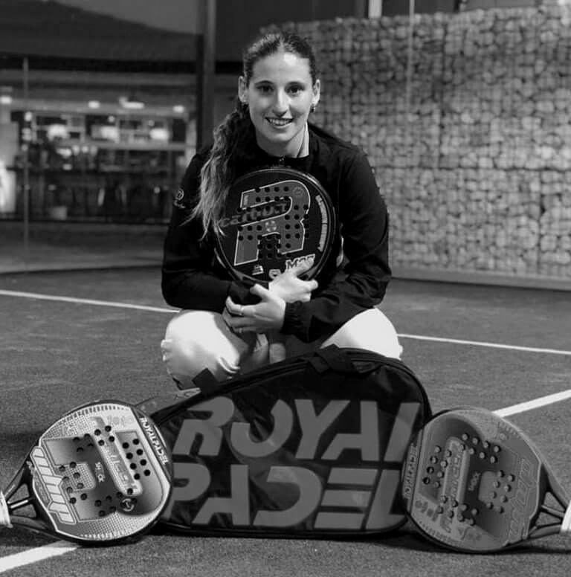
OUR PROGRAM
INTERMEDIATE COACHING PROGRAM
- PROGRESSION FROM BEGINNER TO INTERMEDIATE
- INTRODUCTION TO MOVEMENT AND POSITIONING
- THE BASIC SHOTS REQUIRED FOR INTERMEDIATE
- THE PROGRESSION OF EVERY INTERMEDIATE SHOT
- THE BASIC TACTICS FOR INTERMEDIATE
- COMMON MISTAKES AND HOW TO REMEDY

Slide 11
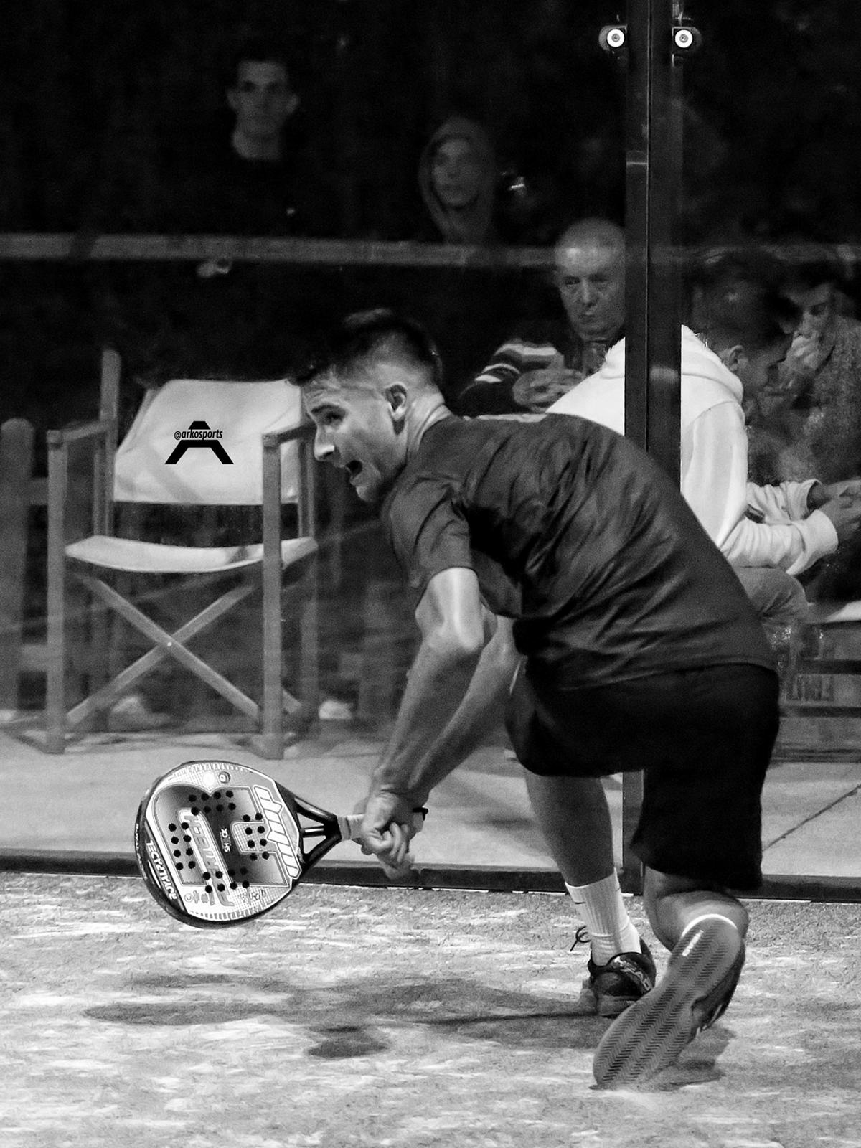
OUR PROGRAM
ADVANCED COACHING PROGRAM
- BASIC SHOTS FOR ADVANCED LEVEL PLAYERS
- REQUIRED PROGRESSION FOR ADVANCED SHOT EXECUTION
- BASIC TACTICS FOR ADVANCED LEVEL PLAYERS
- COMMON MISTAKES AND HOW TO REMEDY
- HOW TO SUCCESSFULLY TRAIN PLAYERS TO BEGIN COMPETING

Slide 12
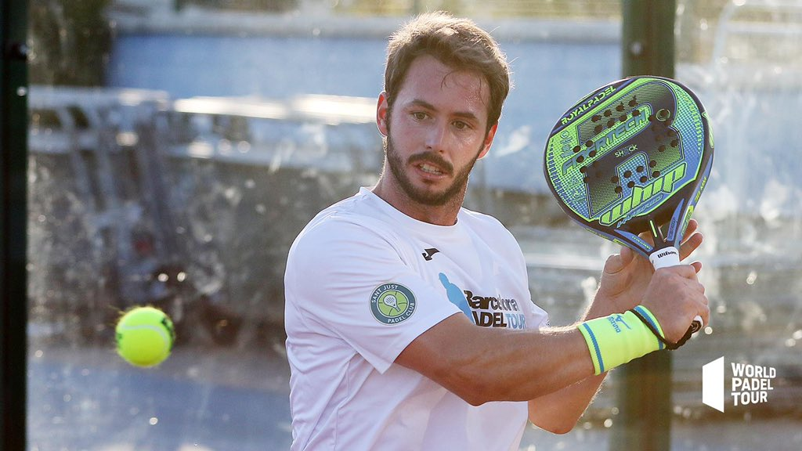
OUR PROGRAM
PRO COACHING PROGRAM
- INTRODUCTION ON HOW TO PLAN FOR A PRO
- BASIC SHOTS FOR PRO PLAYERS
- NATURAL PROGRESSIONS REQUIRED TO EXECUTE PRO LEVEL SHOTS
- ADVANCED MOVEMENT AND POSITIONING FOR PRO LEVEL PLAYERS
- HOW TO SUCCESSFULLY COMPETE AT PRO LEVEL
- VARIABLES AND INFORMATION TO ANALYIZE WHEN TRAIANING PRO PLAYERS
- COMMON MISTAKES AND HOW TO RECTIFY

Slide 13
ACADEMY PROMISE
ROYAL PADEL WILL ENSURE THAT CLUB MEMBER EVENTS AND CLINICS ARE ALWAYS SET AT THE HIGHEST STANDARD POSSIBLE BY OUR COACHES.
MONITORING OF EVENTS AND IMPROVEMENT OF PLAYERS ATTENDING WILL BE OF THE UPMOST IMPORTANCE.
EQUIPMENT AND ACADEMY BANNERS PROVIDED BY ROYAL PADEL FOR PROMOTIONAL PURPOSES.
CERTIFIED ACADEMY COACHES WILL BE PROVIDED CLOTHING FOR COACHING SESSIONS AND FURTHER EVENTS.
#WEAREROYALPADEL

Slide 14
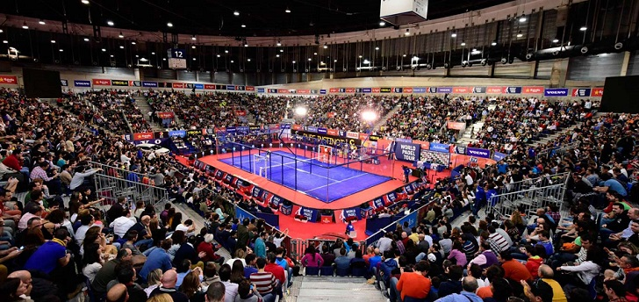
ROYAL PADEL WPT EXPERIANCE
- WORLD PADEL TOUR BARCELONA TICKETS FOR WEEKEND
- PICK UP AND DROP OFF FROM AIRPORT
- DAILY COACHING SESSIONS AND MATCHES IN TOP BARCELONA
CLUBS
- HOTEL AND TRANSPORT TO AND FROM WPT EVENT DAYS
- MEALS PROVIDED IN THE CITY OF BARCELONA

Slide 15
OUR AFFILIATED CLUBS
HERE ARE SOME OF THE CLUBS ALREADY PART OF OUR ACADEMY PROGRAM
YOUR CLUB ?
BONA SPORT BCN
Järfälla PADEL
PADEL INDOOR
YOUR CLUB ?
ONE OF BARCELONA'S OLDEST AND MOST PRESTIGIOUS TENNIS CLUBS HAVE WORKED CLOSELY WITH ROYAL PADEL FOR MANY YEARS.
STOLKHOLMS PREMIER PADEL CLUB IS ALSO THE MAIN TRAINING CENTER FOR THE ROYAL PADEL TRAINING ACADEMY IN SWEDEN.
ONE OF BARCELONA'S MOST SUCCESSFUL AND LARGST PADEL CLUBS. THIS CLUB IS FAVOURITE TO MANY WPT PLAYERS FOR TRAINING.

Slide 16
THANK YOU FROM
WWW.ROYALPADEL.COM

